Slide 1
Machine Learning with Python
Session 2

Slide 2
Python List
Lists are the most versatile of Python's compound data types.
A list contains items separated by commas and enclosed within square brackets ([]).
To some extent, lists are similar to arrays in C.
One difference between them is that all the items belonging to a list can be of different data type.

Slide 3
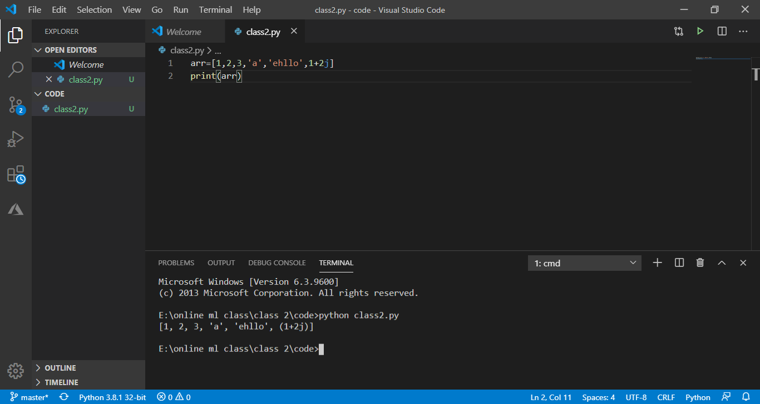

Slide 4
Python Tuple
A tuple is another sequence data type that is similar to the list. A tuple consists of a number of values separated by commas. Unlike lists, however, tuples are enclosed within parentheses.
The main differences between lists and tuples are: Lists are enclosed in brackets ( [ ] ) and their elements and size can be changed, while tuples are enclosed in parentheses ( ( ) ) and cannot be updated. Tuples can be thought of as read-only lists.

Slide 5
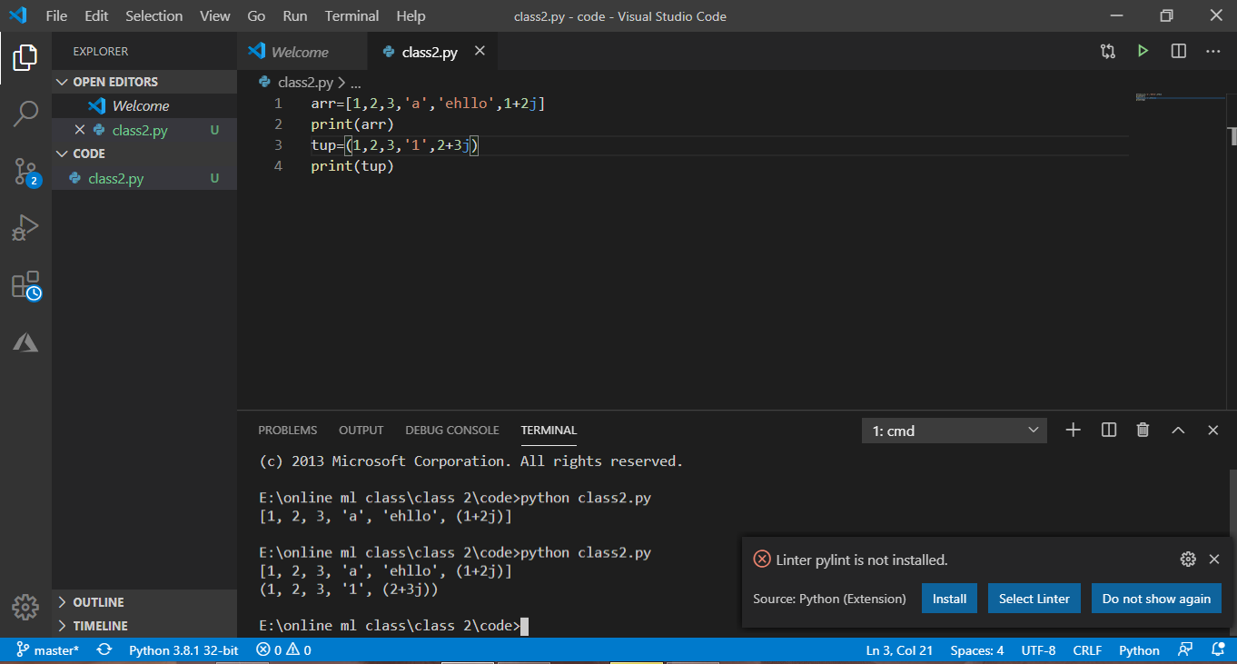

Slide 6
Python Dictionary
Python's dictionaries are kind of hash table type.
They consist of key-value pairs.
A dictionary key can be almost any Python type, but are usually numbers or strings. Values, on the other hand, can be any arbitrary Python object.
Dictionaries are enclosed by curly braces ({ }) and values can be assigned and accessed using square braces ([]).

Slide 7
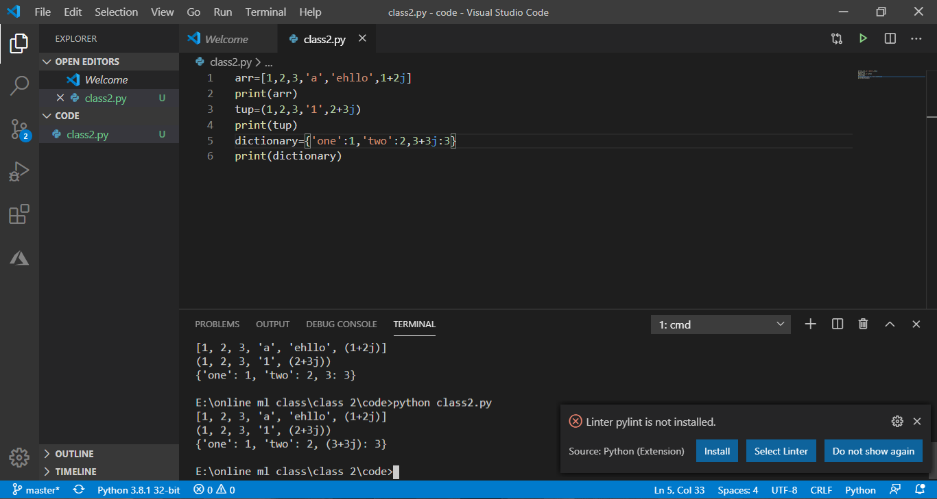

Slide 8
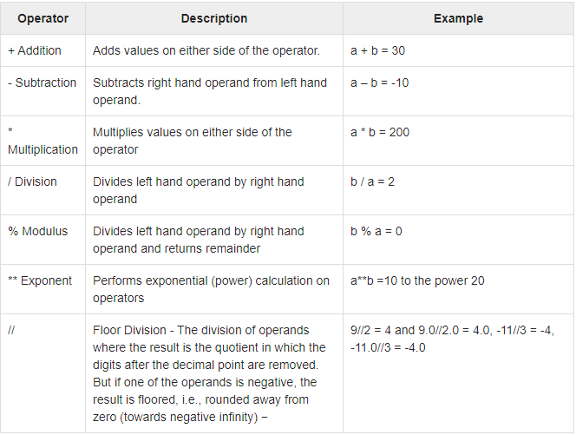
Operations on numbers

Slide 9
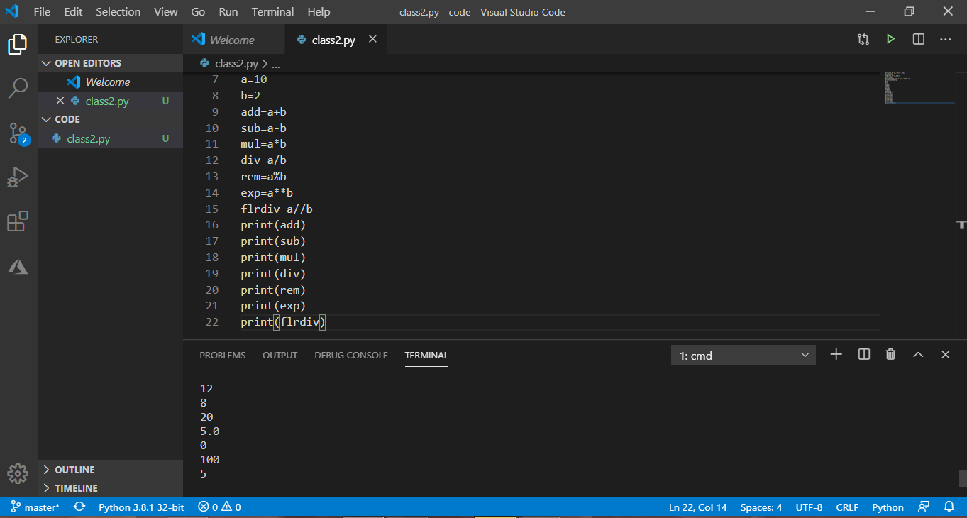

Slide 10
Operation on strings
Accessing []
Updating []
*
+
in
not in

Slide 11
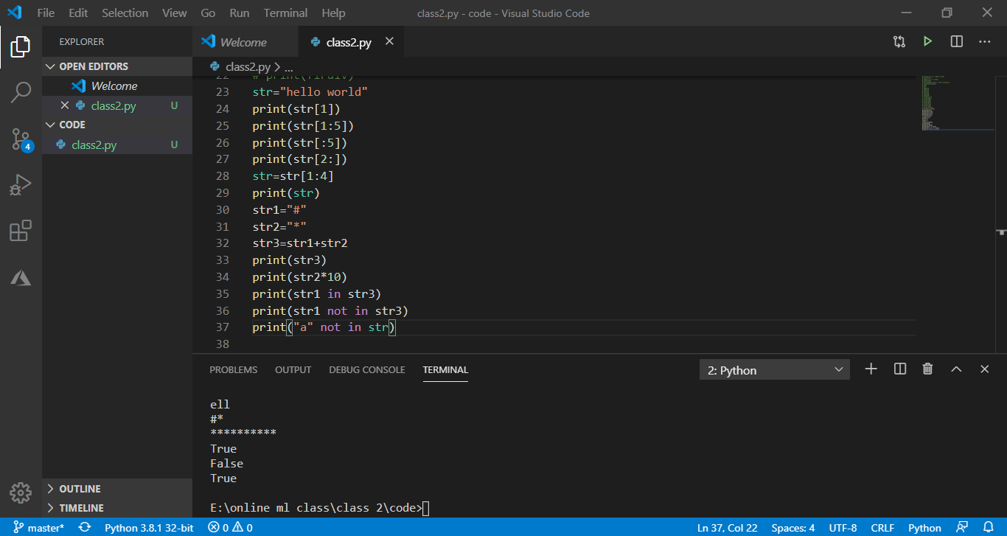

Slide 12
Operation on Lists
Slicing []
Updating []
Concatenation +
Length len
Repetition *
Membership in not in

Slide 13
